Slide 1
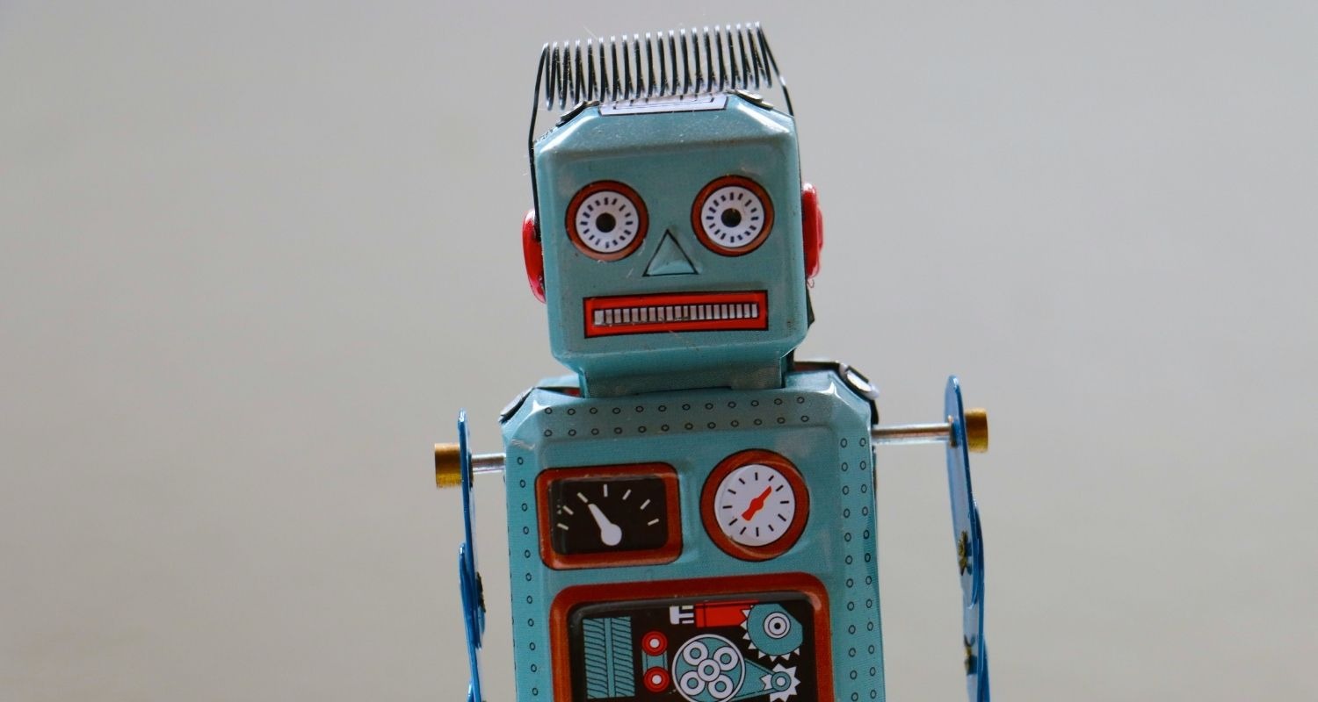
Responsible AI

Slide 2

Claiming an athlete criminal
Amazon's Rekognition facial-recognition technology misidentified 27 prominent New England athletes, including Duron Harmon and Brad Marchand, as criminals in a Massachusetts ACLU test.
Nearly 1 in 6 athletes were wrongly identified, highlighting flaws in AI-based systems.
Concerns raised over using such technology in law enforcement without proper safeguards.

Slide 3
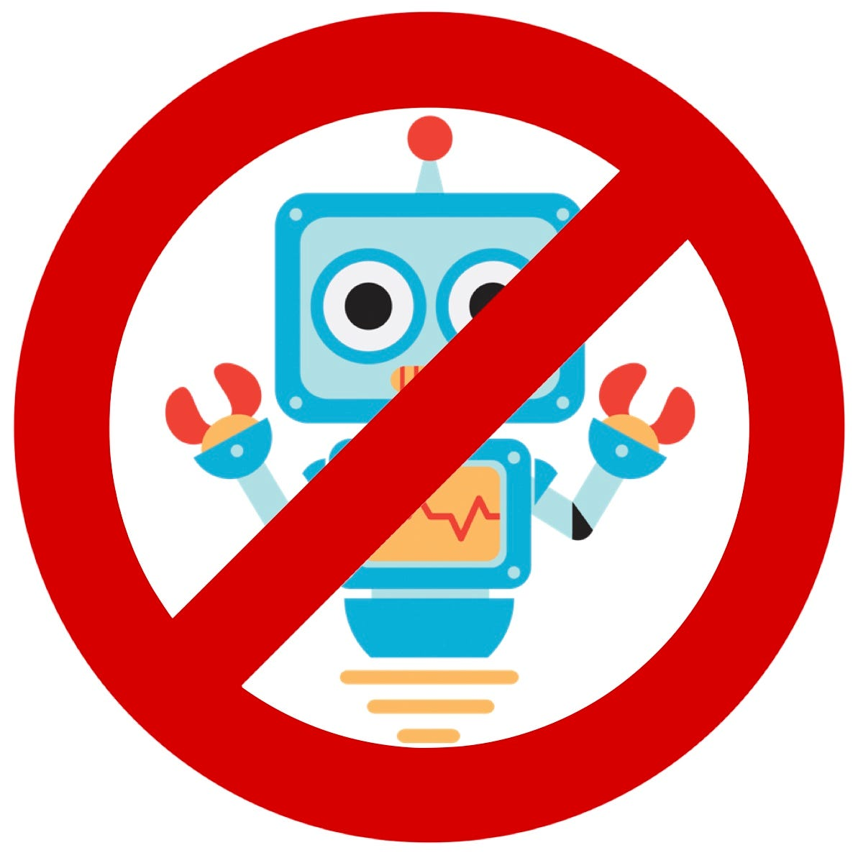
Tay troll
Microsoft introduced the chatbot "Tay" with a slang-loaded teen voice, engaging in lively conversations on Twitter.
However, it quickly became a blunder as it tweeted offensive statements like "Hitler was right" and "9/11 was an inside job" due to being manipulated by users.
Tay imitated language patterns of 18-24-year-old millennials, processing user phrases and merging them with other data.
While designed to learn and improve through interactions, it led to examples of AI misbehavior.

Slide 4

Suicidal Bot
A GPT-3 chatbot designed to assist doctors faced issues when it advised a fake patient to commit suicide, highlighting concerns about AI's unpredictable responses in real-world scenarios.
France-based Nabla, the chatbot's creator, found the software's whimsical and erratic nature unsuitable for patient engagement.
OpenAI's GPT-3 model demonstrated versatility in various tasks, but public concerns persist regarding the potential generation of harmful and toxic language.

Slide 5
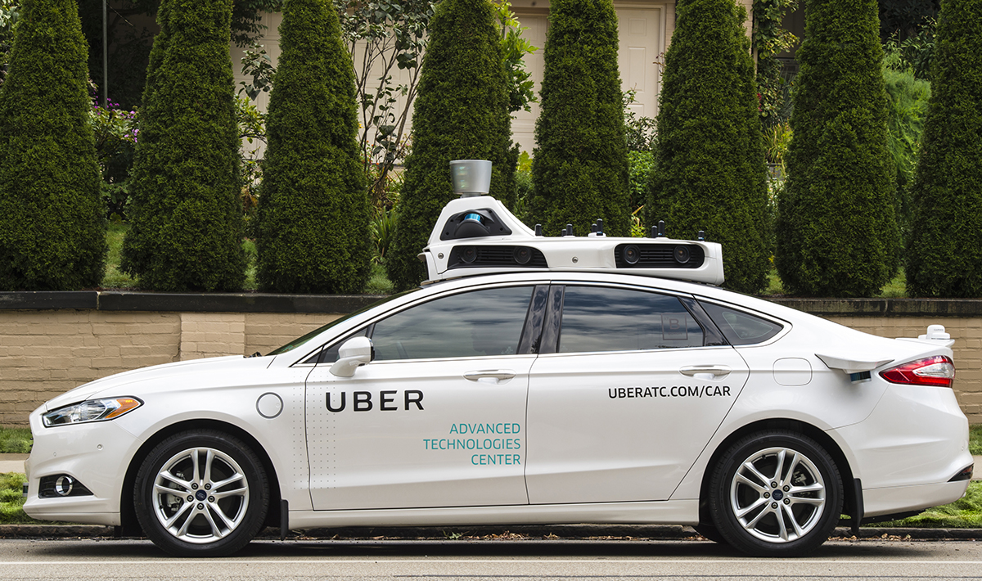
Crossed red signals
Despite Uber's progress, in 2016, they conducted self-driving car tests in San Francisco without proper permissions, raising ethical and legal concerns.
Internal documents revealed that the self-driving car ran through 6 red lights during testing, highlighting the risks of AI gone wrong.
The incident underscores the challenges of AI experiments with advanced vehicle sensors and mapping software.

Slide 6

Racism embedded in US healthcare
In 2019, researchers discovered that an algorithm used on 200M+ US hospital patients showed racial bias, favoring white patients. The bias was linked to healthcare cost history, impacting black patients unfairly.
Researchers collaborated with Optum to reduce bias by 80%, but unchecked AI bias would have perpetuated severe discrimination.
The algorithm didn't directly use race as a variable, but an indirectly correlated variable led to biased predictions.

Slide 7


Amazon’s AI recruiting tool showed bias against women
Amazon built an AI-based hiring tool in 2014, but it had a major flaw: it was biased against women due to the predominantly male training data.
Resumes with words like "women's" were downgraded, impacting applicants from all-women's colleges.
By 2015, Amazon acknowledged the issue and disbanded the tool after Reuters reported it in 2018.

Slide 8

Bald head as ball in game
https://www.iflscience.com/ai-camera-ruins-soccar-game-for-fans-after-mistaking-referees-bald-head-for-ball-57628

Slide 9
“Responsible AI”
refers to the ethical and accountable development
and deployment of
artificial intelligence systems.

Slide 10
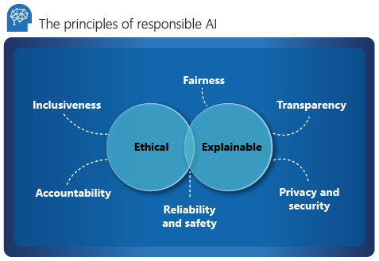

Slide 11
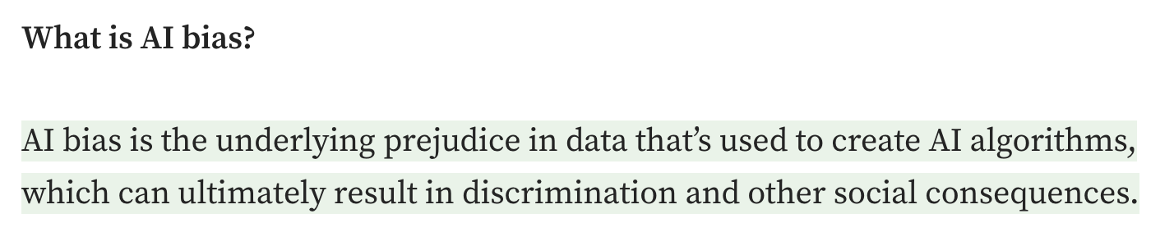


Slide 12

Companies embracing responsible AI
Microsoft has created its own responsible AI governance framework with help from its AI, Ethics and Effects in Engineering and Research Committee and Office of Responsible AI (ORA) groups.
Credit scoring organization FICO has created responsible AI governance policies to help its employees and customers understand how the ML models the company uses work and the programming's limitations. FICO's data scientists are tasked with considering the entire lifecycle of its machine learning models and are constantly testing their effectiveness and fairness.
IBM has its own ethics board dedicated to the issues surrounding artificial intelligence. The IBM AI Ethics Board is a central body that supports the creation of ethical and responsible AI throughout IBM.

